Slide 1

Let's have a look at what we covered yesterday
Introduction to Splunk
What is Splunk?
Key Features of Splunk
Components of Splunk
Installing Splunk
Access Management in Splunk

Slide 2
Today’s Agenda
Day 02
Indexes & Data Onboarding
What are Indexes?
Adding and Onboarding Data into Splunk

Slide 3
SPLUNK OVERVIEW (Module - 2)

Slide 4
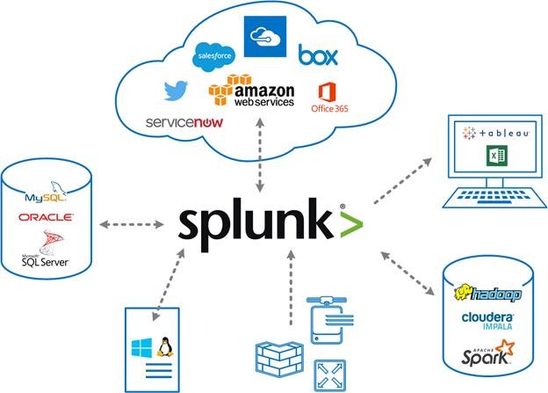
Splunk Data:
Splunk can ingest data from a wide variety of sources, including files, directories,
network events, and APIs. It supports common data formats such as CSV, JSON, and
XML, as well as custom formats.

Slide 5
Indexes:
The repository for data. When the Splunk platform indexes raw data, it transforms the data into searchable events. Indexes reside in flat files on the indexer.
There are two types of indexes:
Events indexes. Events indexes are the default type of index. They can hold any type of data.
Metrics indexes. Metrics indexes hold only metric data.
metric data consists of a numerical measurement called a metric, the metric type, and one or more dimensions.
What is difference between raw data and events?

Slide 6
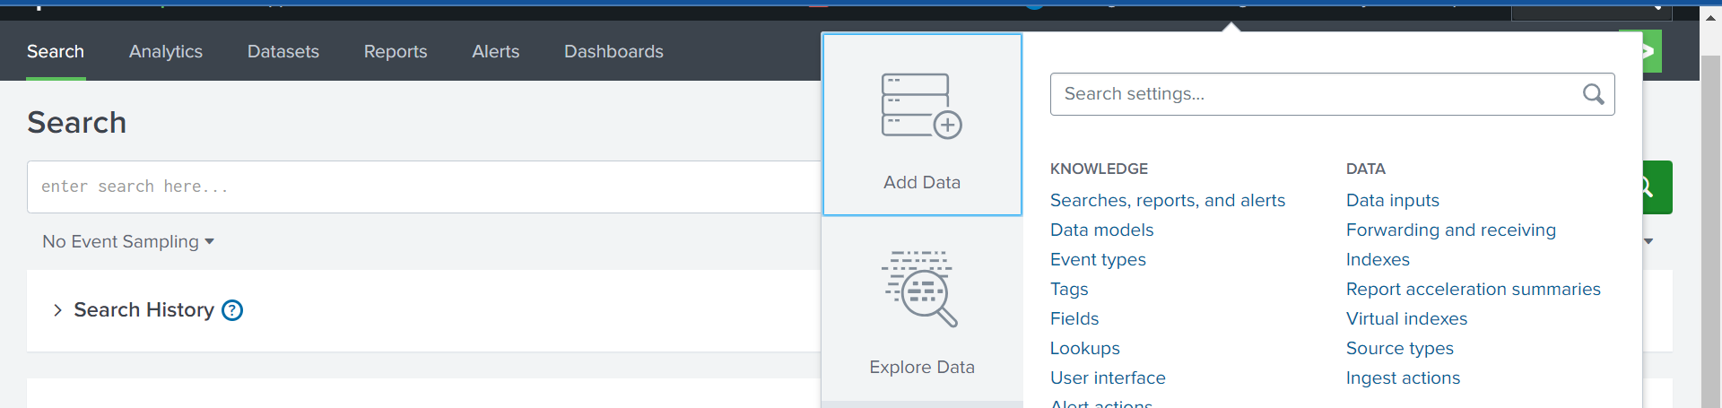
Adding Data into splunk

Slide 7
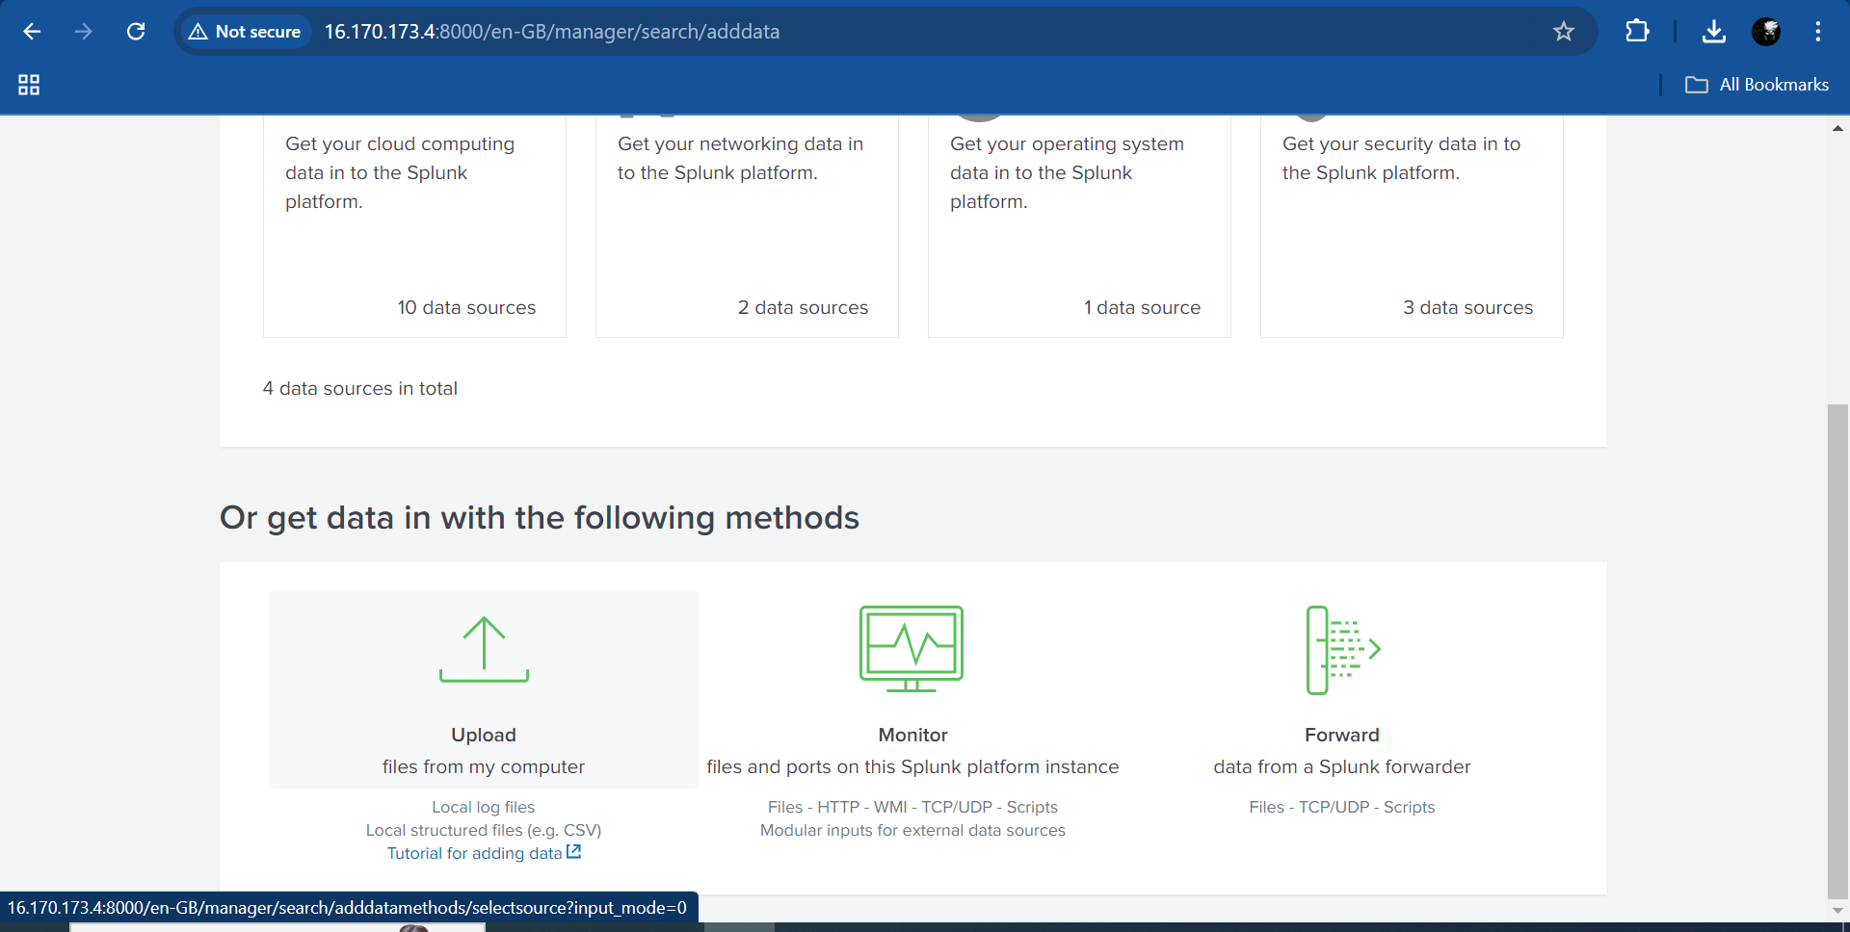
Click on Select file → Upload any file

Slide 8
Steps:
Select sourcetype
Resolve error if there are any
Click on Next
Select index you want to ingest data of your file into.
Click on Review
Click on Submit.

Slide 9
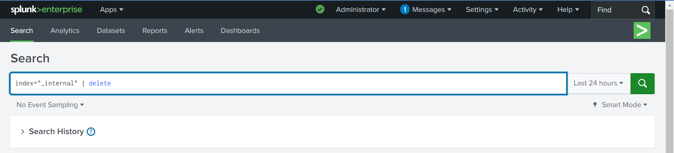
Removing Data:
To remove data using | delete command in search and reporting bar.
Note: It’s very destructive command please do not use it without assistance

Slide 10

What’s Coming Next?
Dive into SPL (Search Processing Language)
What is SPL?
Basic SPL Commands and Real-world Use Cases

Slide 11
Thank You

